Slide 1
Mobile DevOps w/the Microsoft Stack
Abel Wang
Sr Technical PMM .NET, Mobile, DevOps
Developer tools & cloud services
abel.wang@microsoft.com
@abelsquidhead

Slide 2
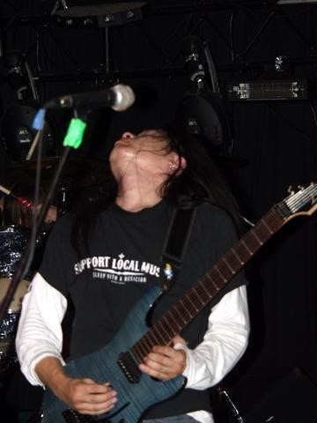


Who am I?
Abel Wang | @AbelSquidHead
Senior Technical Product Marketing Manager for .NET, Mobile and DevOps
Blog at abelsquidhead.com
abel.wang@microsoft.com
Work
Writing code for over 20 years
Process Consultant/Certified Scrum Master
ALM Ranger
VSTS Team
DevOps, General App Dev, Mobile Visual Studio, Azure
Fun Stuff
Rock star in his own mind
Training for the Great Wall Marathon

Slide 3

What is DevOps?
“DevOps is development and operations collaboration”
“DevOps is treating your infrastructure as code”
It’s DevOps!
It’s DevOps!
“DevOps is using automation”
It’s DevOps!
“DevOps is feature switches”
It’s DevOps!
“DevOps is small deployments”
“Kanban for Ops?”

Slide 4





DevOps: the three stage conversation
DEV
OPS
1
People
2
Process
3
Products
Notes:
People = Culture
Fundamental attributes of successful cultures:
Shared mission and incentives: infrastructure as code, apps as services, DevOps/all as teams
You need to consider your hardware as a commodity, (don't give your servers names) , servers are like farm animals, it is just harder if you let theids name them
Build deep instrumentation into services, push complexity up the stack
Rally around agile, shared metrics, CI, service owners on call, etc.
Changing the culture: any change takes time, changing culture is no exception and you can't do it alone, exploit compelling events to change culture: downtimes, cloud adoption, devops buzz
PROCESS Definition and design, compliance, and continuous improvement
PEOPLE Responsibilities, management, skills development, and discipline
Products Tools and infrastructure

Slide 5



Process
1
4
Plan
Monitor + Learn
Development
Production
2
3
Develop + Test
Release

Slide 6
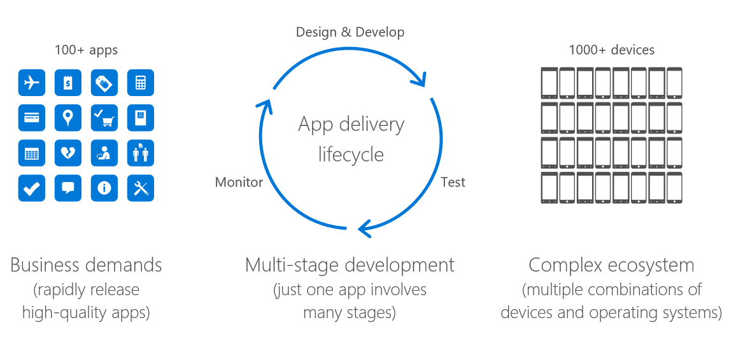
Mobile DevOps Challenges

Slide 7
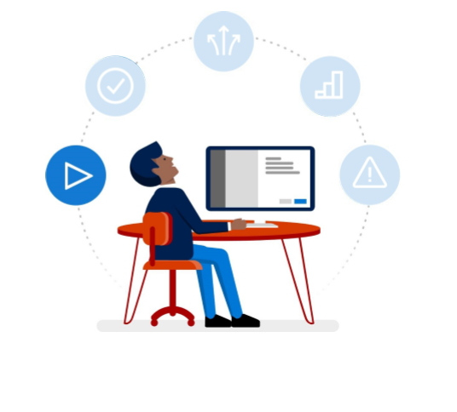
Continuous Integration
Every commit
Build
Unit Test
Sign
Package
Drop Artifacts

Slide 8
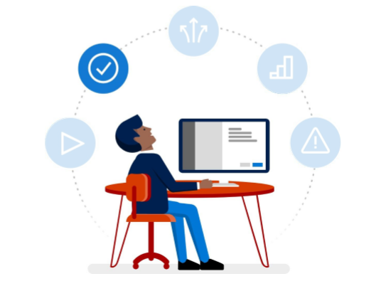
Automated UI testing
2,500+ real devices and
400+ configurations
Frameworks
Xamarin.UI Test
Calabash
Appium
Espresso*

Slide 9
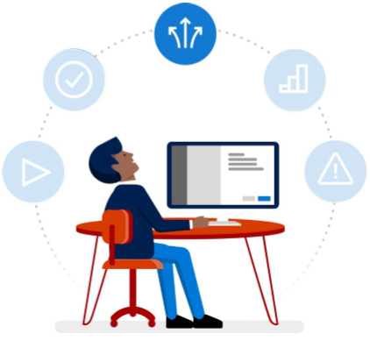
Continuous Deployment – Alpha/Beta
Distribute builds to internal
and external testers
Control distribution groups
Automatic and manual
deployment

Slide 10
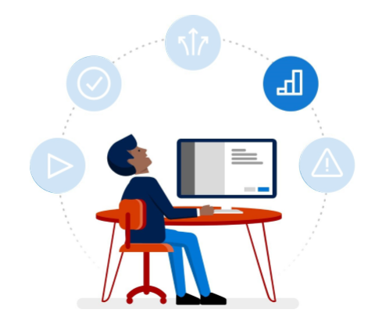
Analytics

Slide 11
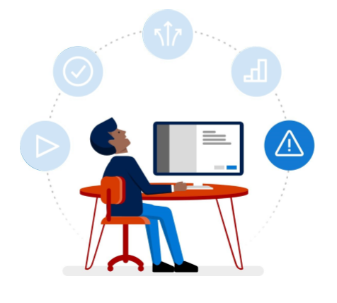
Crash Reporting

Slide 12





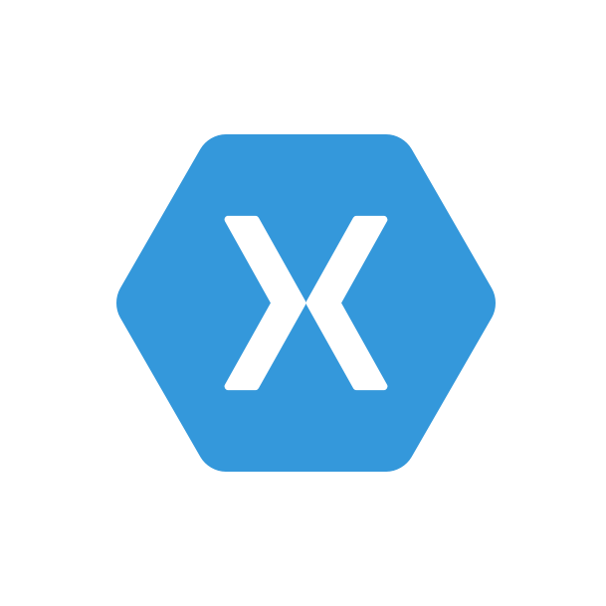

Mobile Dev Ops Pipeline
Code Repository
Build + Deploy
App Testing
Beta Testing
Backlog
Telemetry Collection
Monitor and improve

Slide 13
Live Update
Crash Reporting
A/B Testing
Storage
Identity
Push Notifications
Remote Config.
Tables

Slide 14
ANNOUNCING
Push Notifications
A/B Testing
Visual Studio Mobile Center
Crash Reporting
Remote Config.
Identity
Mission control for mobile apps
Storage
Live Update
Tables
:-)

Slide 15
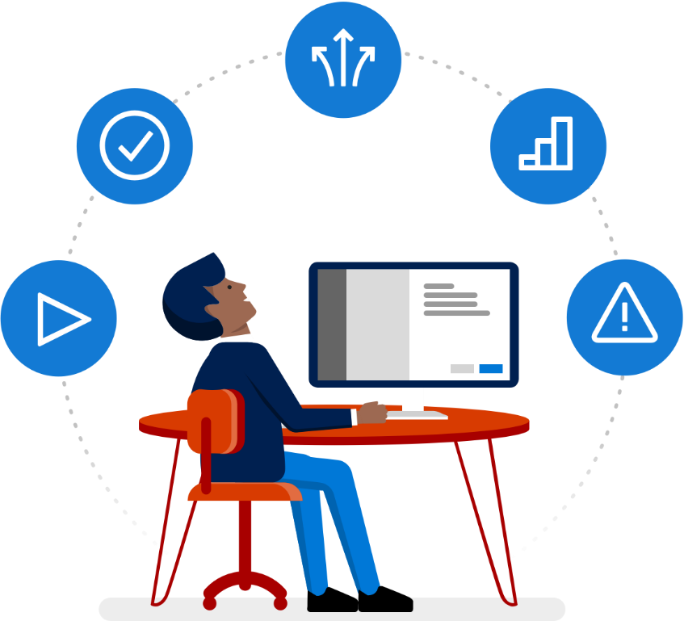
Connect all of your mobile apps
Automate your entire mobile app lifecycle in a few easy steps
Streamline your workflow, no matter which programming language you use.
Connect your apps to continuous integration, automated testing, distribution, and feedback capabilities.
Release higher quality apps faster.
Get the time and data you need to focus on developing what your users want.

Slide 16
Resources
Mobile Center (Preview)
visualstudio.com/vs/mobile-center
Mobile Center Documentation
aka.ms/mobilecenterdocs
Mobile Center Webinar Series
aka.ms/mobile-center-webinars

